Slide 1
Sales Management System
Mini Project Presentation
Presented by: Thaheer Course: (Data Science) Institution: GUVI

Slide 2
PROBLEM STATEMENT
Problem Statement
Manual sales tracking is inefficient
Difficult to track payments
Errors in calculating pending amount
No centralized system

Slide 3
OBJECTIVE
Objective of the Project
Manage customer sales efficiently
Track received and pending payments
Automate calculations
Provide a simple dashboard

Slide 4
TECHNOLOGIES USED
Technologies Used
MySQL → Database Management
Python → Backend Logic
Streamlit → Frontend UI
Pandas → Data Processing

Slide 5
DATABASE DESIGN
Database Design
Tables Created:
branches
users
customer_sales
payment_splits
Relationships:
Foreign keys used to connect tables
Ensures data consistency

Slide 6
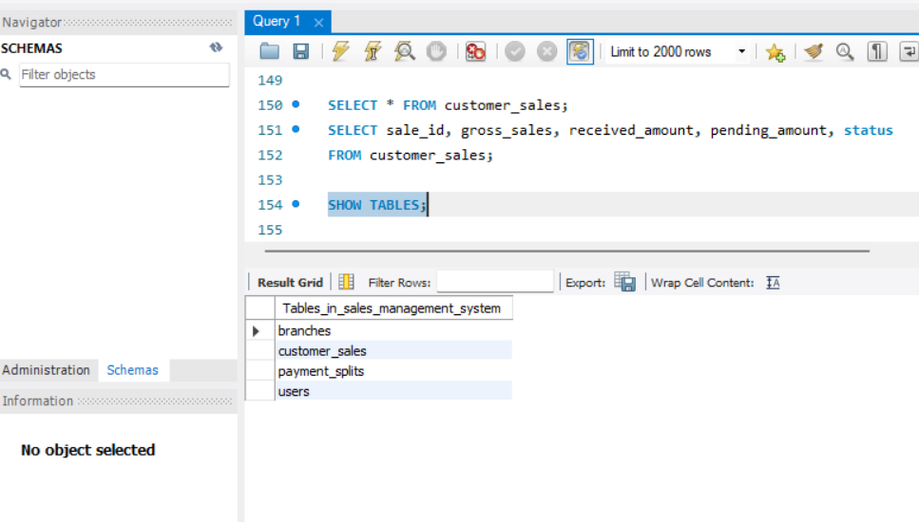
Database Tables Structure

Slide 7
SYSTEM ARCHITECTURE
User ⬇
Streamlit Interface ⬇
Python Backend ⬇
MySQL Database

Slide 8
TRIGGERS
Triggers automatically update:
received_amount
pending_amount
status (Open / Close)
When:
Payment is inserted
Payment is updated
Payment is deleted

Slide 9
FEATURES
Key Features
Secure Login System
Dashboard with KPIs
Sales Data View
Add Payment Functionality
Automatic Updates using Triggers

Slide 10
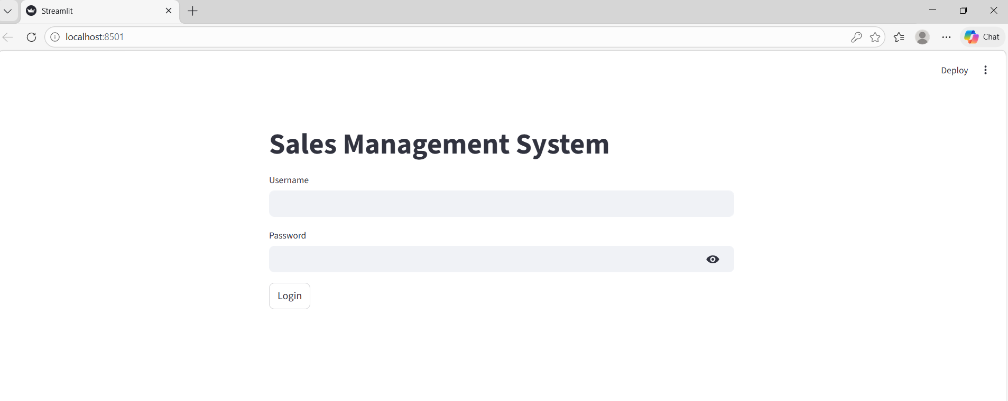
LOGIN PAGE

Slide 11
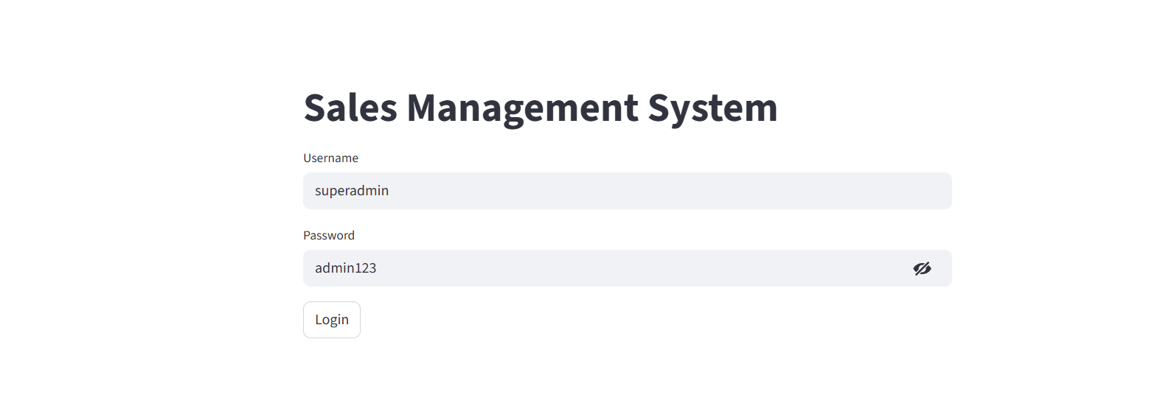

Slide 12
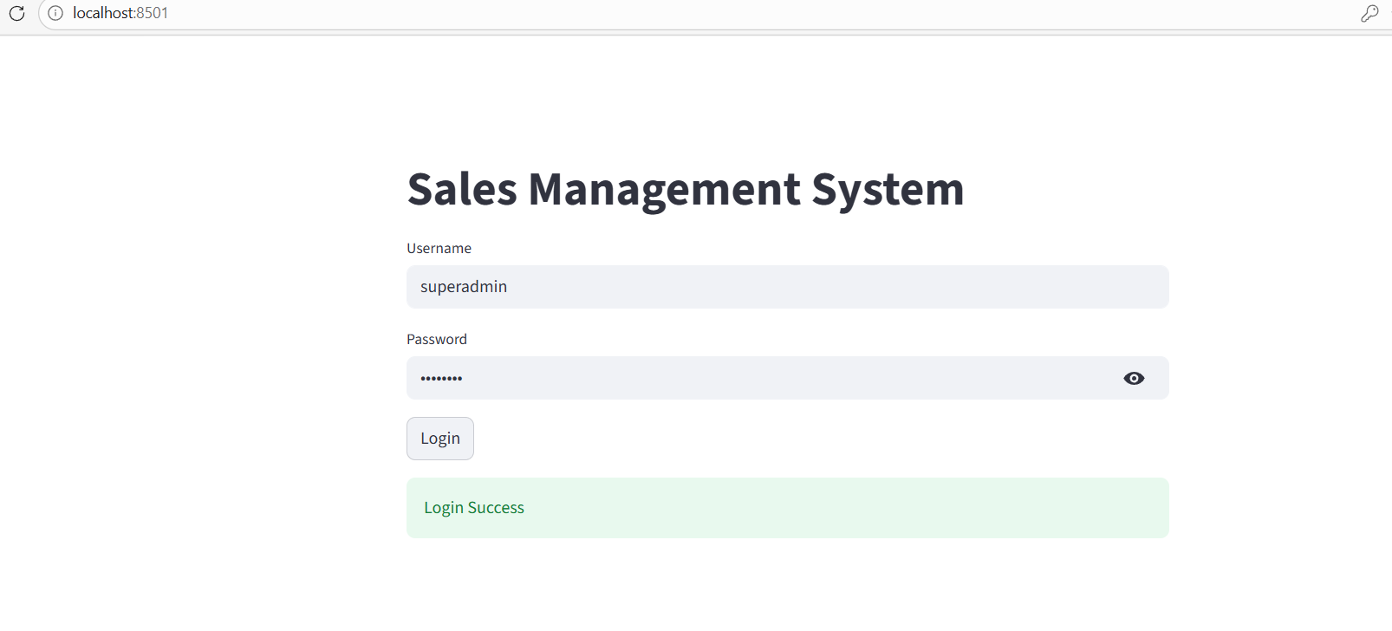

Slide 13
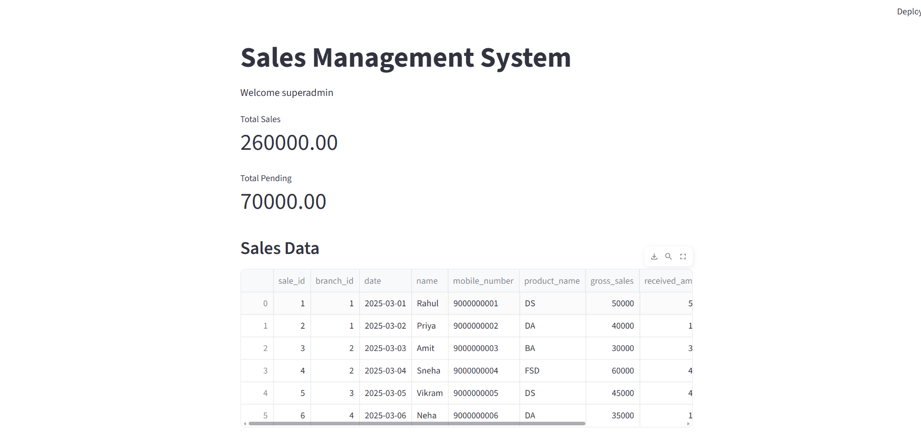
DASHBOARD OUTPUT

Slide 14
SALES DATA OUTPUT
Sales Data Table
Customer details
Gross Sales
Received Amount
Pending Amount
Status (Open / Close)

Slide 15
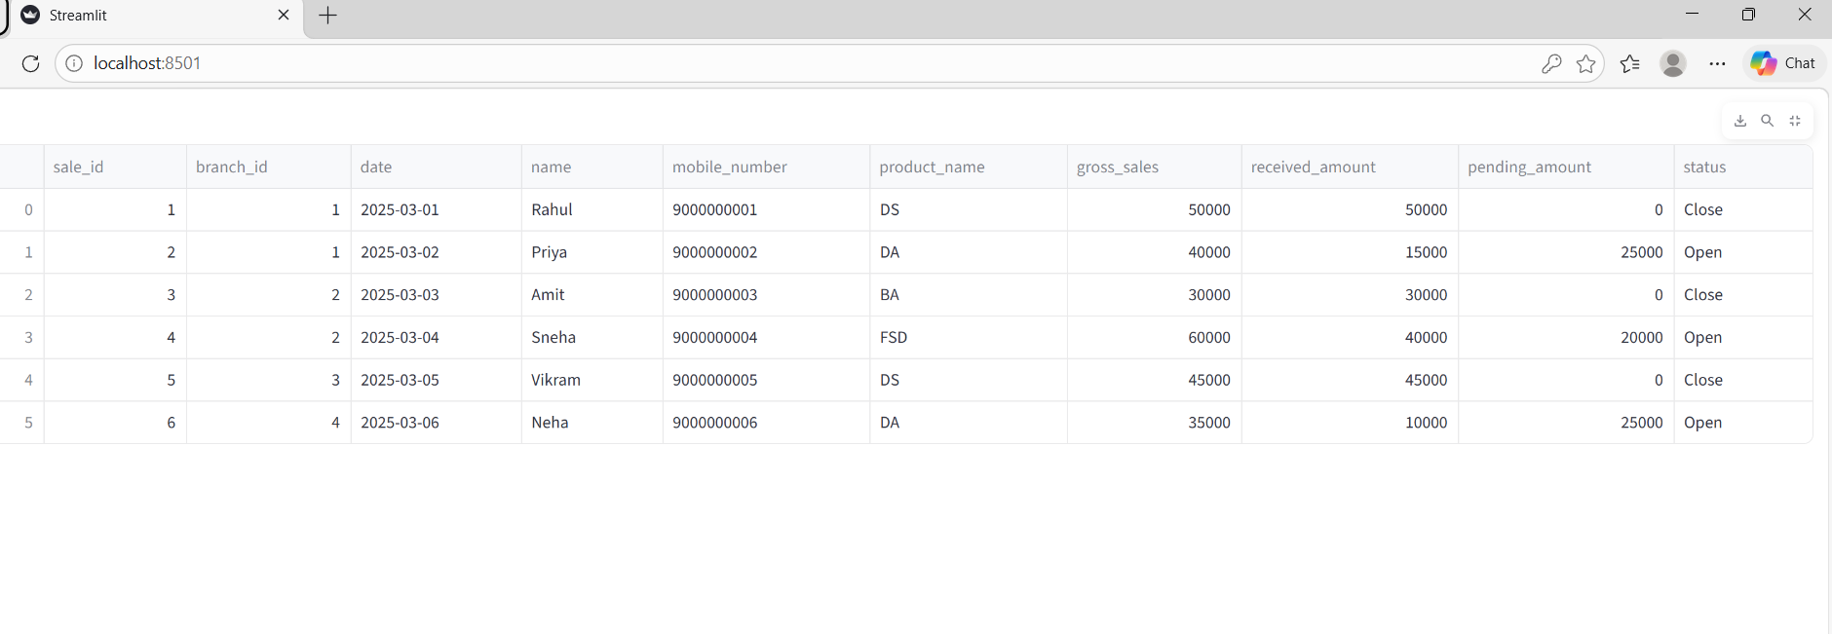

Slide 16
ADD PAYMENT
Add Payment Feature
User can add payment
Trigger automatically updates:
received amount
pending amount
status

Slide 17
SQL QUERIES IMPLEMENTED
BASIC QUERIES (5)
1. Retrieve all records from customer_sales SELECT * FROM customer_sales;
2. Retrieve all records from branches SELECT * FROM branches;
3. Retrieve all records from payment_splits SELECT * FROM payment_splits;
4. Display all sales with status = 'Open' SELECT * FROM customer sales WHERE status = 'Open’;
5. Retrieve all sales belonging to Chennai branch SELECT cs.* FROM customer_sales cs JOIN branches b ON cs.branch_id = b.branch_id WHERE b.branch_name = 'Chennai';

Slide 18
AGGREGATION QUERIES (5)
Total gross sales across all branches SELECT SUM(gross_sales) AS total_gross_sales FROM customer_sales;
Total received amount SELECT SUM(received_amount) AS total_received FROM customer_sales;
Total pending amount SELECT SUM(pending_amount) AS total_pending FROM customer_sales;
. Count total sales per branch SELECT branch_id, COUNT(*) AS total_sales FROM customer_sales GROUP BY branch_id;
. Average gross sales SELECT AVG(gross_sales) AS avg_sales FROM customer_sales;

Slide 19
JOIN QUERIES (3)
Sales with branch name SELECT cs.sale_id, cs.name, b.branch_name FROM customer_sales cs JOIN branches b ON cs.branch_id = b.branch_id;
Sales with total payment received SELECT cs.sale_id, cs.name, SUM(ps.amount_paid) AS total_paid FROM customer_sales cs JOIN payment_splits ps ON cs.sale_id = ps.sale_id GROUP BY cs.sale_id, cs.name;
Branch-wise total gross sales SELECT b.branch_name, SUM(cs.gross_sales) AS total_sales FROM customer_sales cs JOIN branches b ON cs.branch_id = b.branch_id GROUP BY b.branch_name;

Slide 20
FINANCIAL QUERIES (2)
1. Sales where pending > 5000 SELECT * FROM customer_sales WHERE pending_amount > 5000;
2. Payment method-wise total collection SELECT payment_method, SUM(amount_paid) AS total FROM payment_splits GROUP BY payment_method;

Slide 21
CONCLUSION
Conclusion
Successfully developed a Sales Management System
Reduced manual effort
Ensured data accuracy
Demonstrated real-time updates using triggers

Slide 22
FUTURE ENHANCEMENTS
Future Enhancements
Role-based access control
Advanced reports
Export to Excel/PDF
Improved UI design

Slide 23
THANK YOU

